Slide 1

BENG 122A Final Project
Blood glucose control in hypoglycemia
Abijith Augustine, Paya Vatanshenas,Elliott Calderon, Capalina Melentyev, Matthew Tam

Slide 2
TABLE OF CONTENTS
01
02
03
04
05
06
Problem setting
Glucagon pathophysiology
problem statement
Expected results
Experiment
CONCLUSION

Slide 3
Problem Setting
Blood glucose level management is critical for individuals with diabetes to maintain overall health and prevent complications associated with hypo- and hyperglycemia.
Hypoglycemia poses risk to individuals using insulin or other blood glucose-lowering medications
We will study complex variables involving nonlinear dynamics of glucose and glucagon in a setting of a hypoglycemic system
The mathematical model will incorporate the conditions for hypoglycemia and its dynamics over glucose and glucagon in our preliminary brainstorming and scientific journal design.
Notes:
Elliot

Slide 4
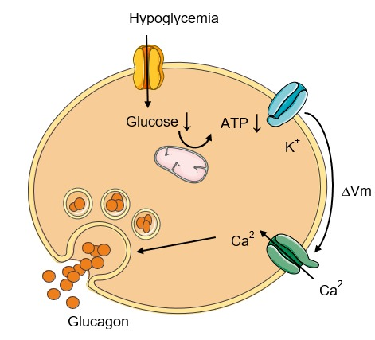
Glucagon Pathophysiology
Glucose falls beneath 70 mg/dL
Lack of glucose causes ATP in beta cell to decrease causing a potassium pump to close
Potassium pump closing causes a change in potential in the cell that causes calcium to rush in
Increase in calcium ion increase the production and excretion of the hormone glucagon out of the cell and into the plasma
Notes:
Elliot

Slide 5
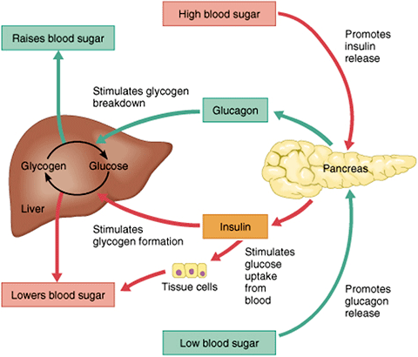
Glucagon Pathophysiology (cont.)
Glucagon is released into the bloodstream from the pancreas
Glucagon stimulates glycogen breakdown in the liver
Glycogen breakdown creates more glucose , thus bringing the blood sugar back up to a normal range. Average value being 96 mg/dL
Notes:
Elliot

Slide 6
Problem Statement
Project aims to design, analyze, simulate, and explore a control system for blood glucose regulation during hypoglycemia using MATLAB and SIMULINK
The mathematical representation will capture the dynamics of blood glucose concentration and glucagon concentration in response to perturbations from the hypoglycemic system
We will analyze and design a controller for the feedback for the system
Notes:
Paya
Our project aimed to design, analyze, and simulate a constant hypoglycemic environment and the regulation of blood glucose in response to this environment. With this hypoglycemic environment comes the need for increase in glucose, driven by the increase of glucagon release from the pancreas.

Slide 7
Expected Results/Performance Goals
Since we are analyzing a hypoglycemic environment, blood glucose levels are low, so we plan on seeing an increase in blood glucose levels and an increase in glucagon
We want to model a system that can represent the physiological factors that affect blood glucose levels when levels are low
Notes:
Paya

Slide 8



Equations modeling glucagon response
O(t)= glucagon production
C(t)= plasma concentration of glucagon
G(t)= plasma concentration of glucose
e(t) = Glucose error measurement
T = Hypoglycemia threshold value 70 mg/dL
Glucagon PID feedback Error function
Glucagon rate of change
Glucose rate of change
Notes:
Capalina
Assumptions: didnt consider insulin, more dynamics: exercise, physiological state, everyone has their own metabolism rates

Slide 9
Working table of values
A = 0.2 [1L] | The average total blood volume is 5 liters.
𝛕 = 1/200 [1/min] | Glucagon takes 180-200 min to settle after it spikes in the bloodstream.
T = 0.388[mmolL] | Healthy Glucose level in the bloodstream for a healthy adult.
Kp = 0.006 [L/min*mmol] Ki =0 [L/min*mmol] Kd = 1 [L/min*mmol] | Control parameters for the glucose homeostasis model
k = 0.005 | Rate constant for glucose production
G = 0.1 [mmolL] | Initial Concentration for Glucose
C = 0.7[mmolL] | Initial Concentration for Glycogen
Notes:
Capalina

Slide 10
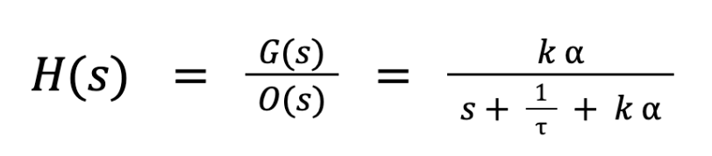
Transfer Function
Notes:
Matty
-1 pole at -1/t

Slide 11
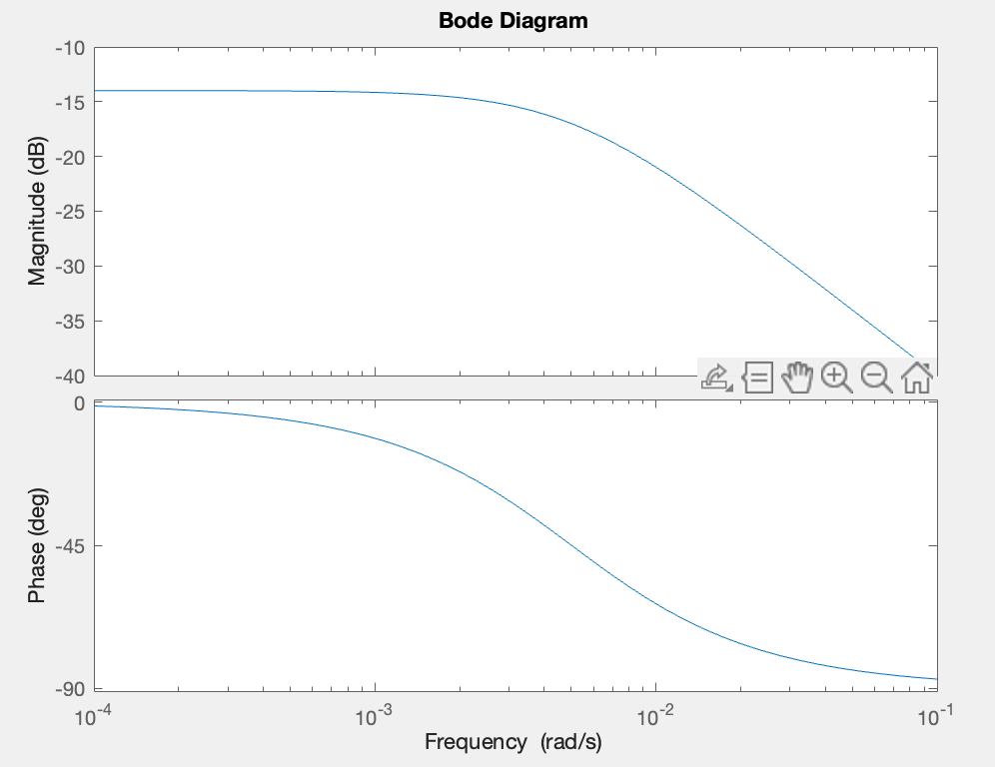
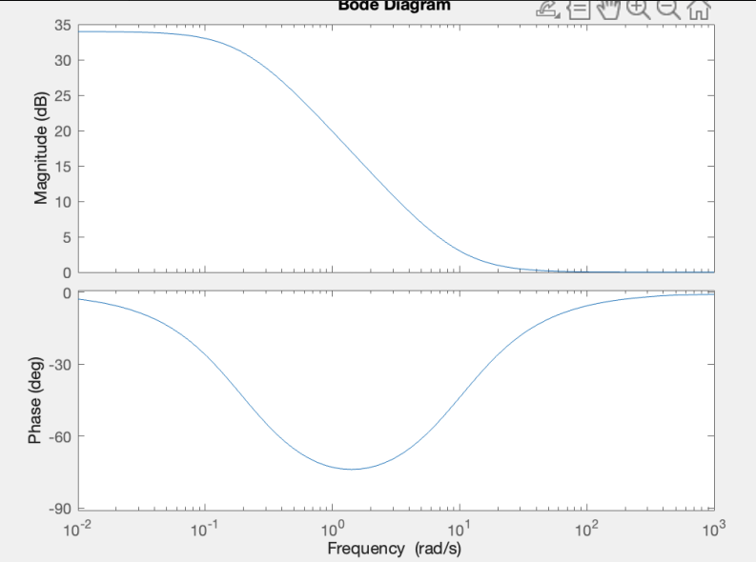
Control System
Bode Plot before (Left) and after (right) PD control is applied.
Notes:
-PD controller acts as low-pass filter, as The D term acts to dampen the response by providing a corrective action based on the rate of change of the error- sensitive to high frequency changes so they are suppressed- causing it to act as a low pass filter. Should also improve the stability of the system by damping the response.
-The P term contributes to the controller output based on the magnitude of the error. It amplifies the error to generate a control action.
- Matty

Slide 12
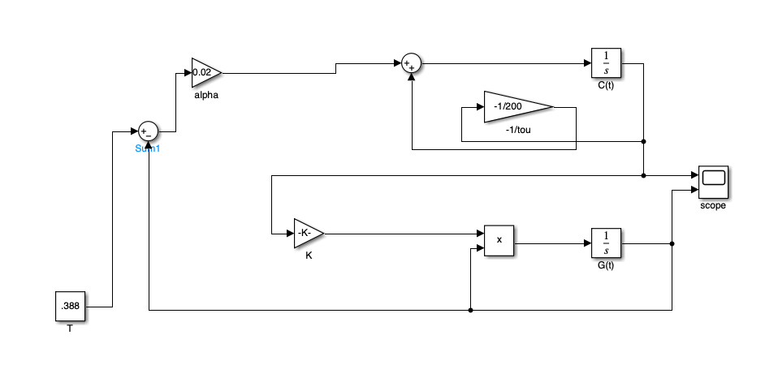
Simulink Model
G(t) represents glucose and C(t) represents glucagon \
Added in .3888 mmol/L of glucose to reach target value of glucose bloodstream
0.005 is the k constant
Tells us about the consumption of the insulin when it combines with glucose to make glucagon
Step function is the input of glucagon
Notes:
Abjith

Slide 13
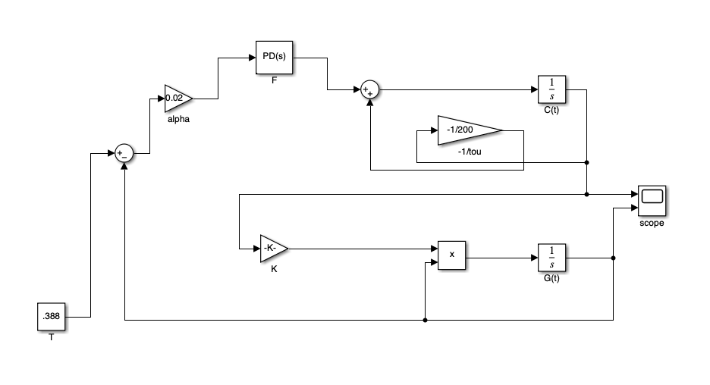
Simulink Model with PID
PD controller maintains homeostasis in people with type one diabetes
Proportional controller regulates glucagon infusion rate when blood glucose levels fall below a threshold
Maintains blood glucose levels while keeping plasma glucagon concentration in an acceptable range
Control parameters set to Kp=0.005, Kd=1
Notes:
Abjith

Slide 14
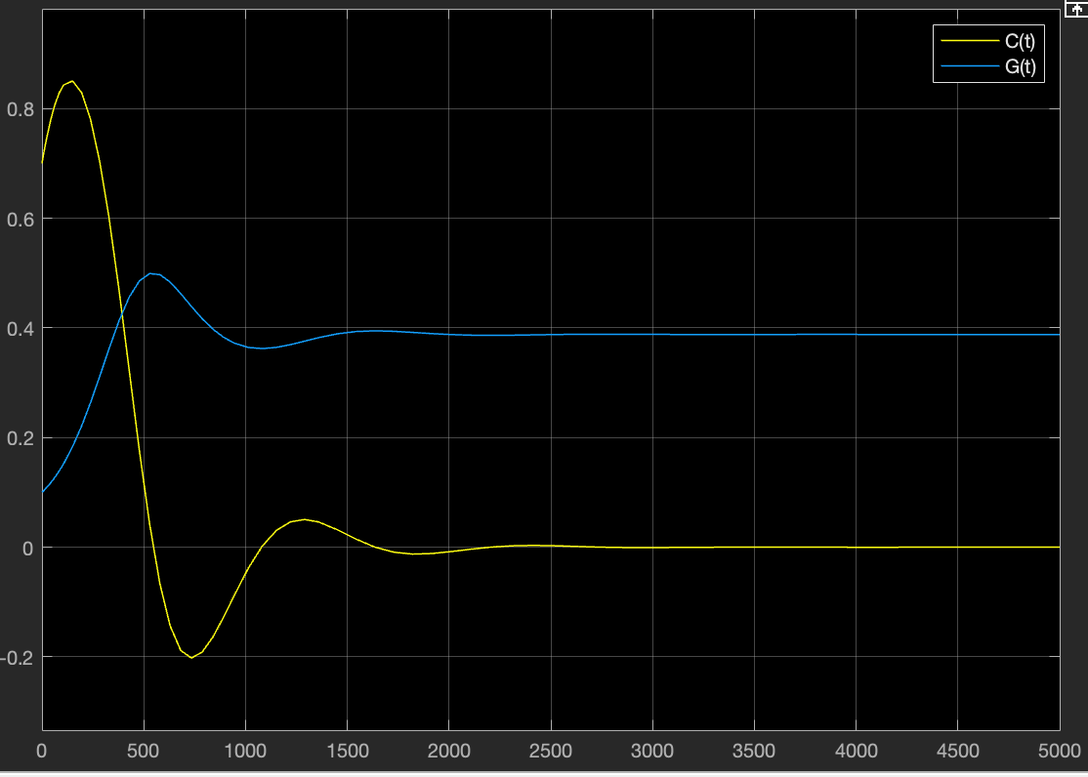
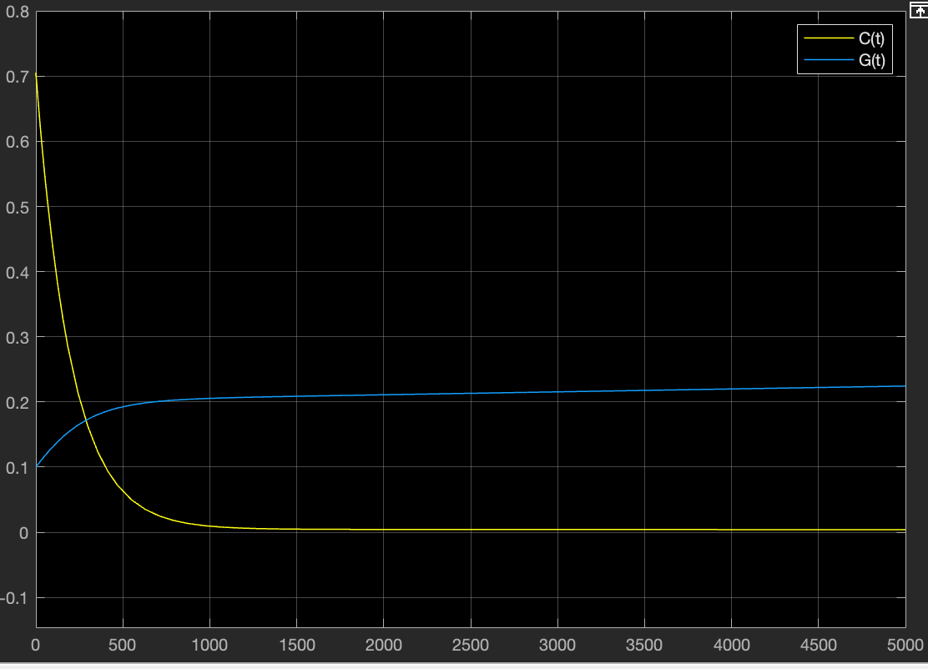
Results
Top: Without PID controller
Bottom: With PID controller
Blue: Glucose
Yellow: Glucagon
Without PID, glucagon spikes higher and oscillates at a baseline of 3.88
The high Kp damped the response to improve settling
The Kd lowered the rise time
Notes:
Abjith

Slide 15
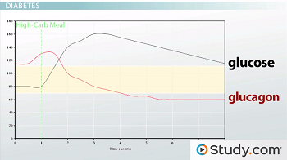
Physiological Observations
Healthy blood glucose levels are at 96 mg/dL
Hypoglycemia occurs when blood glucose levels fall below 70 mg/dL
Eating contributes to keeping healthy blood glucose levels
From: “Homeostasis of Glucose Levels: Hormonal Control and Diabetes - Video & Lesson Transcript [6]
Notes:
Paya

Slide 16
Works cited
[1] Ramnanan, C. J., Edgerton, D. S., Kraft, G., & Cherrington, A. D. (2011). Physiologic action of glucagon on liver glucose metabolism. Diabetes, obesity & metabolism, 13 Suppl 1(Suppl 1), 118–125. https://doi.org/10.1111/j.1463-1326.2011.01454.x
[2] Morettini, M., Burattini, L., Göbl, C., Pacini, G., Ahrén, B., & Tura, A. (2021). Mathematical Model of Glucagon Kinetics for the Assessment of Insulin-Mediated Glucagon Inhibition During an Oral Glucose Tolerance Test. Frontiers in endocrinology, 12, 611147. https://doi.org/10.3389/fendo.2021.611147
[3] Kelly, R. A., Fitches, M. J., Webb, S. D., Pop, S. R., & Chidlow, S. J. (2019). Modelling the effects of glucagon during glucose tolerance testing. Theoretical biology & medical modelling, 16(1), 21. https://doi.org/10.1186/s12976-019-0115-3
[4] enugopal SK, Sankar P, Jialal I. Physiology, Glucagon. [Updated 2023 Mar 6]. In: StatPearls [Internet]. Treasure Island (FL): StatPearls Publishing; 2023 Jan-. Available from: https://www.ncbi.nlm.nih.gov/books/NBK537082/
[5] Morettini, M., Burattini, L., Göbl, C., Pacini, G., Ahrén, B., & Tura, A. (2021). Mathematical Model of Glucagon Kinetics for the Assessment of Insulin-Mediated Glucagon Inhibition During an Oral Glucose Tolerance Test. Frontiers in endocrinology, 12, 611147. https://doi.org/10.3389/fendo.2021.611147
[6]Wright, Sarah. “Homeostasis of Glucose Levels: Hormonal Control and Diabetes - Video & Lesson Transcript | Study.com.” Study.com, 2019, study.com/academy/lesson/homeostasis-glucose-levels-and-osmolarity-hormonal-control.html.

Slide 17
Thank You for Listening!
Questions?

