Slide 1
Infrared Waves for Switch Activated Toys
Chloe Chen, Kimi Hiji, Maymon Naing, Inika Shakya, & Sabrina Sanchez

Slide 2
Overview
01
02
03
04
05
06
07
08
Background
Aim of Study
Assumptions
Equations / Transfer Function
Model
Results
Clinical Applications
References

Slide 3
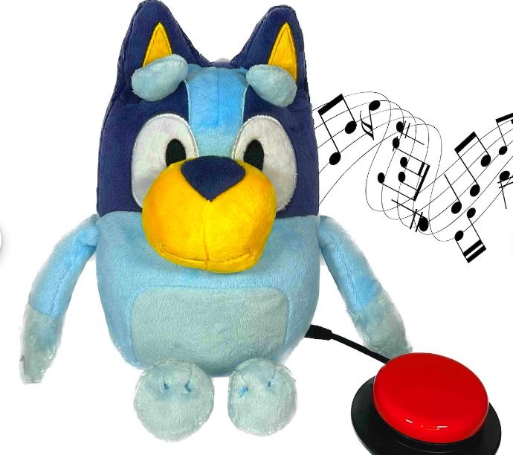
Background
Switch Adapted Toys
Infrared Receivers
Created to address the demand for more accessibility in toys
The toy’s internal circuitry is modified to activate by an external switch that is connected to the toy
Current challenges: high cost, demand, limited availability/awareness for accessibility for play technology
Allows for system to detect the infrared light wavelength to the receiver
Example: TV remote control
Toy -> Infrared receiver
Switch -> Infrared light diode
Along with bandpass filter, the activation of switch will send response to toy to turn on

Slide 4
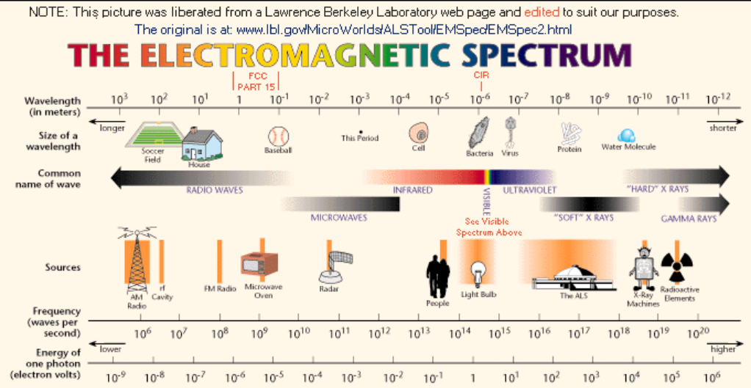
Light Frequencies
Light Source | Frequency
Fluorescent Light | 50-60 Hz
Sunlight | 10^18 Hz
General infrared light | 3*10^11 - 4*10^14 Hz
Typical LED IR remote control | 3 * 10^14 Hz

Slide 5
Aim of Study
Infrared Receiver
Model an infrared receiver to detect for infrared wavelength/frequency using adapted switch to activate the toy
Transfer Function
Create a transfer function that includes a second order narrowband bandpass filter to allow for the specific frequency range desired (infrared frequency)
Evaluate Output
Analyze the output of the system, view its efficacy in real life situations such as an adaptable toy-switch mechanism

Slide 6
Assumptions and Limitations
Assumptions
Limitations
This system only models the infrared receiver
The bandpass filter must be specific because of other light input/ noise
Frequency of the infrared wavelength was too large for Simulink
Notes:
For our project, there were a couple assumptions and limitations that we took into consideration while designing our system. Starting with the assumptions, we assumed that this system only models the infrared receiver. So, it does not take into account any other part of the switch/ circuit system, such as the button. The second consideration we had was that the bandpass filter must be specific because of other light input/ noise. Light sources such as from the sun or flashes of light will also be captured by the photodiode, so that is why it is important that our bandpass filter only includes the frequency coming from the infrared light. Next, moving on to the limitations, the main limitation that we took into mind was that the frequency of the infrared wavelength was too large for Simulink. The values of the transfer function were too high because of the time constant, so we lowered our input frequency by 10^14 so we could see the graph in Simulink.

Slide 7
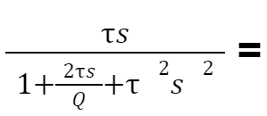

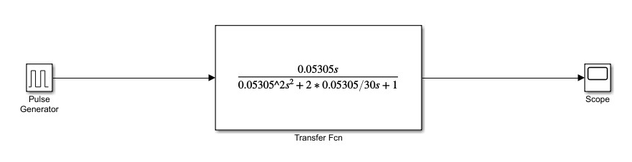

Equations
Transfer Function
Variables
(Scaled down by 10^14)
Fc = 3 = infrared frequency
Tau = 0.05305 =
Bandwidth = 0.1
Q = 30 =
Notes:
Our transfer equation listed above represents the bandpass filter of our system. The variables listed above are scaled down by 10^14 because they were too big for simulink, as said earlier in the assumptions. The center frequency was based of the frequency of infrared and the bandwidth was made small so the filter would be more specific to infrared light. We calculated tau through the center frequency and was able to find the transfer function thereafter. A quality factor was added to the equation of our transfer function so it would be underdamped instead of critically damped, making the filter more specific to only infrared light passing through.

Slide 8
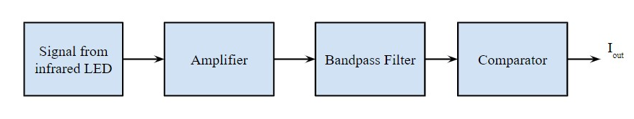
Simulink Model
Block diagram of model needed for application
In simulink we modeled the frequency response of the transfer function of narrowband bandpass filter
Pulse generator had an amplitude of 0.5 m and period of ⅓ sec

Slide 9
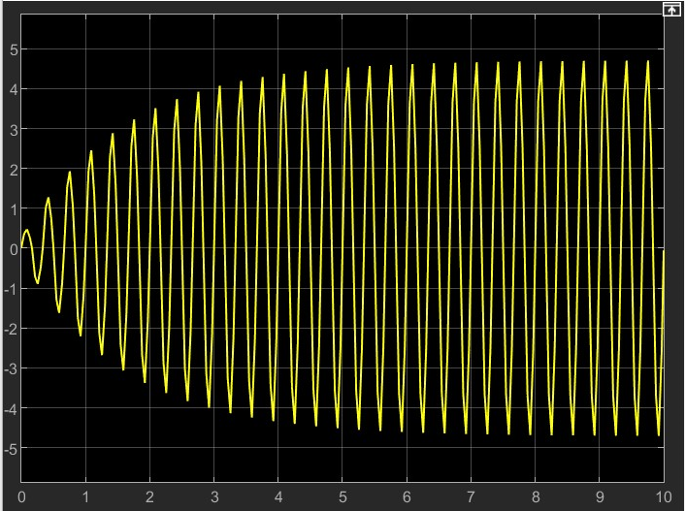
Plot
Plot shows the frequency response over 10 seconds
This the expected graph of the narrowband bandpass filter
In the application of this model the desired threshold can be set around 4.4Hz
If the captured frequency is above this threshold, the toy will be activated

Slide 10
Results
Result from plot: response to a narrow band bandpass filter to a square-wave, periodic signal → bingo!
Quality factor (Q) ↑, the narrower/more selective the bandpass filter.
Q ↑, time it takes for the response to settle ↑
(for the output response from the filter to rise from 0 to the nominal amplitude, as well as from nominal amplitude to 0)
With the plot observed, we can set our activating frequency to a threshold of
4.4 tHz → toys activated!
Notes:
From the plot that we got from the model, we can see that it is an output of a narrow band bandpass filter to a square-wave periodic signal. The bandwidth of signal is determined by the quality factor Q, and for our model, we have selected Q of 30, to ensure that the filter is selective to only the frequency transmitted by the infrared switch, and ignore all other irrelevant frequencies, such as the fluorescent light, sunlights, or other remote controls. The high quality factor also stabilizes the system, in the sense that less energy is dissipated during each oscillations, which makes for a longer settling time from 0 to nominal amplitude, and then vice versa when the switch is deactivated. With the results we have gotten, keeping in mind that we have scaled the model from 300 tetra Hz to 3 hz, we are able to set a activating frequency of around 440 tetra Hz for our receiver on our toy, so that the toys would only be activated once the threshold is reached.

Slide 11
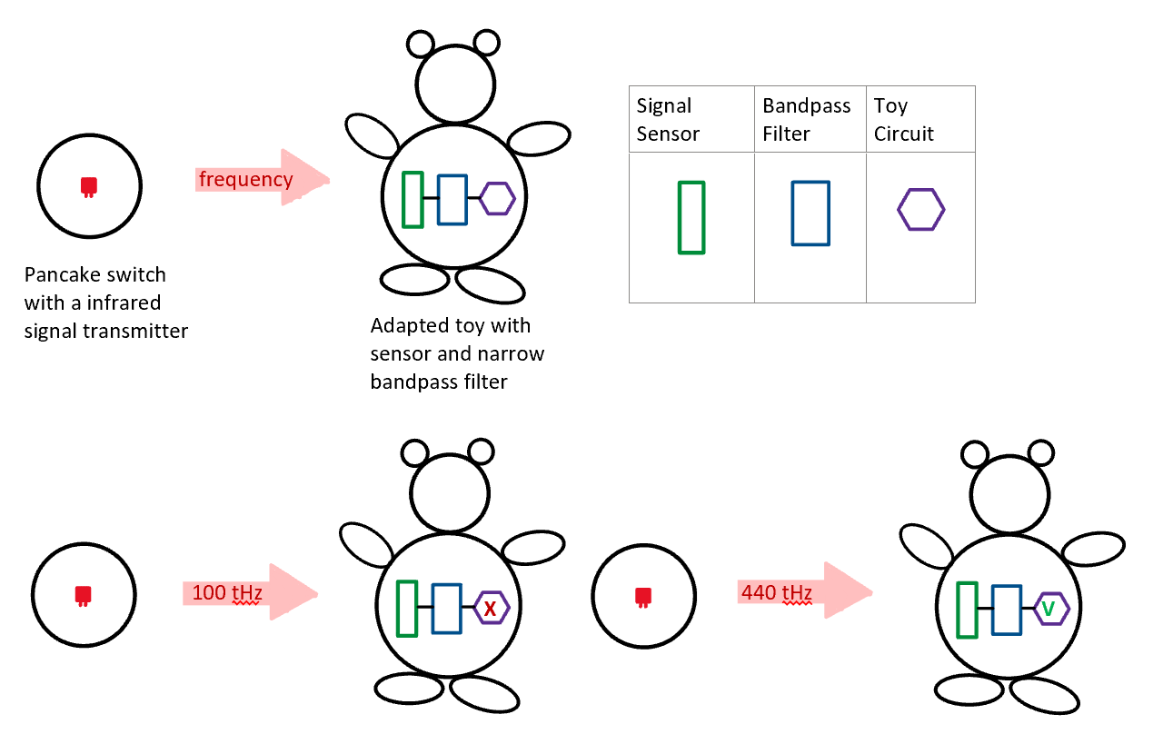
System
Schematic

Slide 12
Clinical Applications
Infrared waves and band pass filters can also be used in a multitude of other clinical applications as well.
Infrared Imaging
Infrared imaging is where infrared light is used to measure slight temperature changes of the body. This type of imaging is used in neuroscience and neurosurgery.
Functional Near-Infrared Spectroscopy
Functional Near-Infrared Spectroscopy(fNIS) is an imaging system similar to fMRI. It scans the hemoglobin species inside the brain by measuring the absorption of light.
Band Pass Filter
Band pass filters also play a huge role in many medical devices. Some of these might include electrocardiographs and electroencephalographs. The band pass filters acts to select a specific frequency and filter out noise.

Slide 13
References
[1] Chen, W.-L., Wagner, J., Heugel, N., Sugar, J., Lee, Y.-W., Conant, L., Malloy, M., Heffernan, J., Quirk, B., Zinos, A., Beardsley, S. A., Prost, R., & Whelan, H. T. (2020). Functional near-infrared spectroscopy and its clinical application in the field of neuroscience: Advances and future directions. Frontiers in Neuroscience, 14. https://doi.org/10.3389/fnins.2020.00724
[2] Electrical4U. (2021, April 16). Band pass filter: What is it? (Circuit, Design & Transfer Function). https://www.electrical4u.com/band-pass-filter/#google_vignette
[3] Etsy. (n.d.). Switch adapted talking bluey plush toy adapted toy speech - etsy. https://www.etsy.com/listing/1576828549/switch-adapted-talking-bluey-plush-toy
[4] Fundamentals of IR and RF Remote Control. IR/RF recording/playback. (n.d.). https://www.laser.com/dhouston/ir-rf_fundamentals.html#:~:text=A%20typical%20Consumer%20IR%20receiver,to%20the%20same%20940nm%20wavelengthv
[5] Khoshakhlagh, A., & Gunapala, S. D. (2017). Infrared imaging: a potential powerful tool for neuroimaging and neurodiagnostics. Neurophotonics, 4(1), 011014. https://doi.org/10.1117/1.nph.4.1.011014
[6] Quality factor and bandwidth. Quality Factor and Bandwidth - Filters - Basics Electronics. (2021). https://ecstudiosystems.com/discover/textbooks/basic-electronics/filters/quality-factor-and-bandwidth/
[7] Transfer functions. Transfer Functions - Filters - Basics Electronics. (2021). https://ecstudiosystems.com/discover/textbooks/basic-electronics/filters/transfer-functions/
[8] What is a band pass filter? (2023, June 2). Collimator. https://www.collimator.ai/reference-guides/what-is-a-band-pass-filter
[9] Zhou, S., Xia, X., Gao, Y., Rong, L., Lourenco, M., & Homewood, K. (2021, August 4). A simple integratable silicon photodetector ... - wiley online library. Advanced Photonics Research. https://onlinelibrary.wiley.com/doi/10.1002/adpr.202100091

Slide 14

Thanks!
Do you have any questions?
Thank you to Dr. Cauwenberghs and Benjamin for all the guidance and help this quarter!

