Slide 1

Optimizing Exogenous Testosterone Dosage for Male Hypogonadism
Michael Fong, Estefania Enciso Pelayo, Rishab Madabhushanam, Shubham Singh, Sujit Tunuguntla
Notes:
Today we are going to talking about…

Slide 2
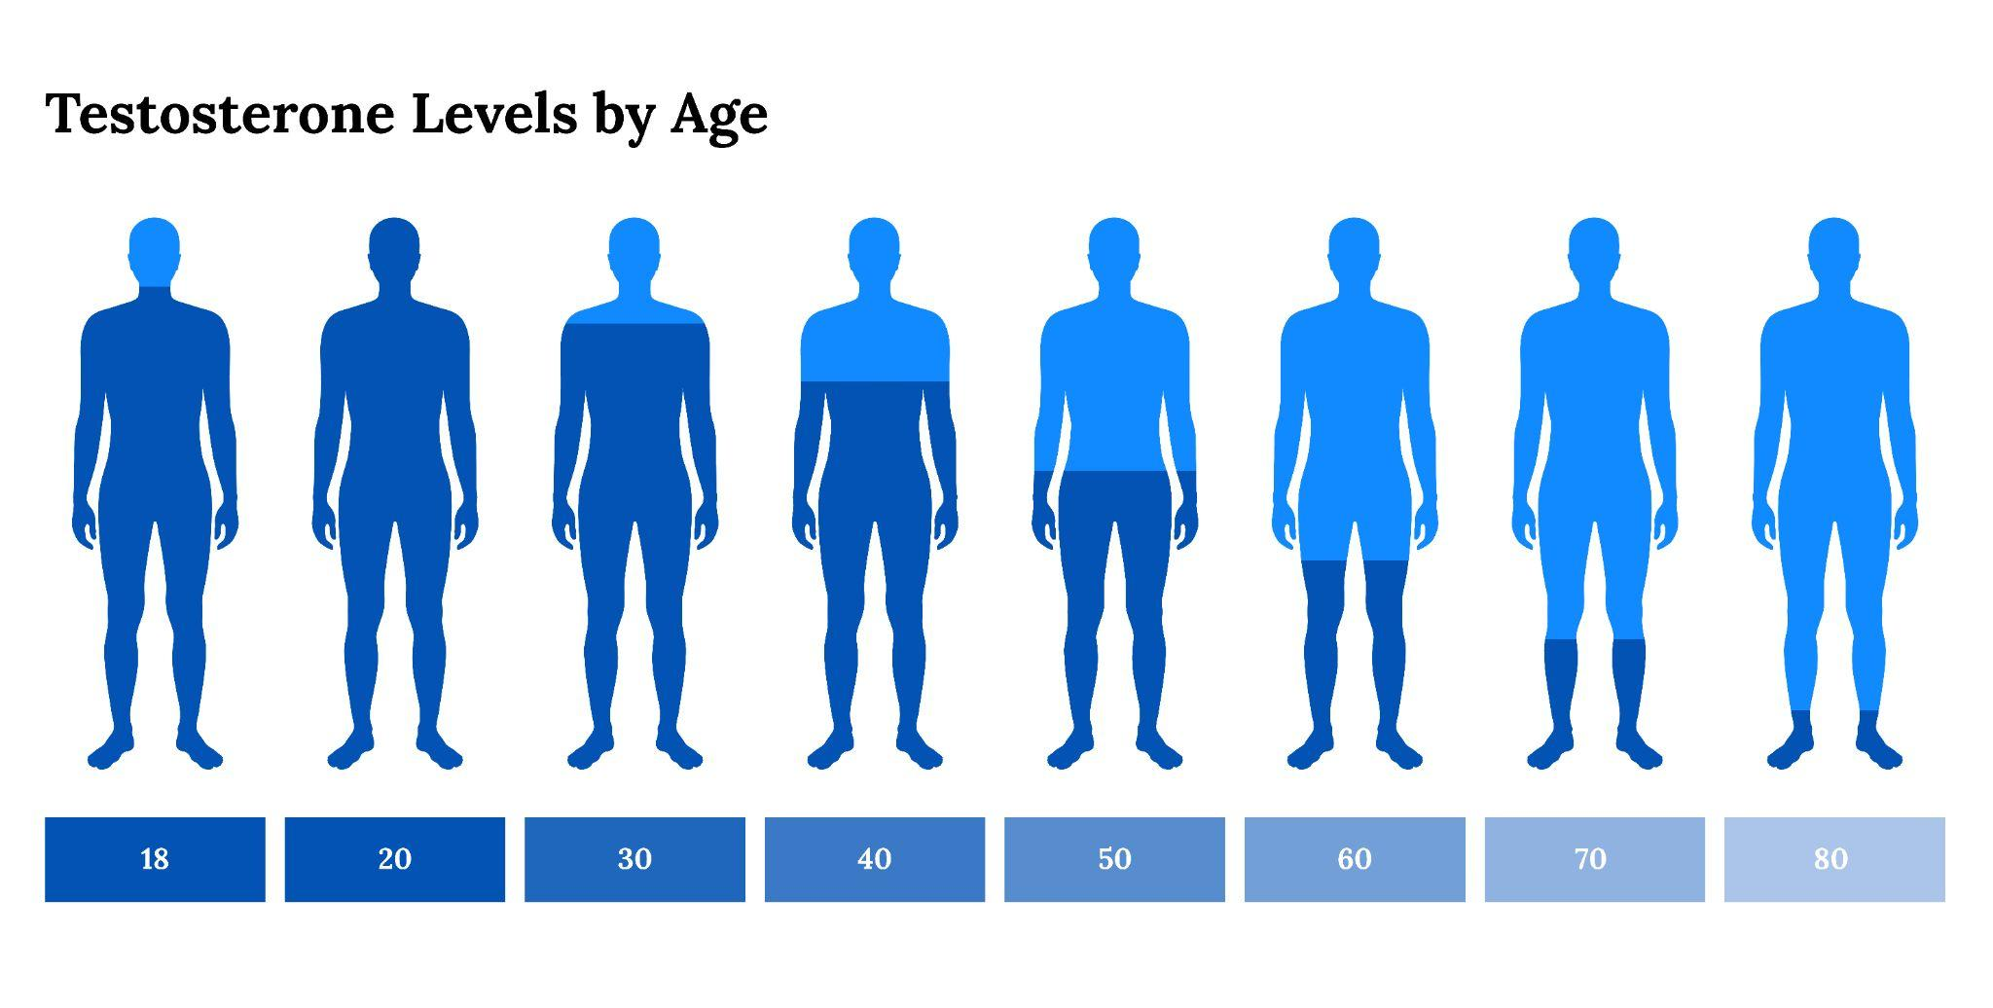
Overview
Testosterone is essential to men’s mental health, energy levels, and physical function.
Men lose testosterone as they age
  Hypogonadism can lead to symptoms like fatigue, depression, muscle weakness
Testosterone Replacement Therapy (TRT) is a process used to elevate testosterone levels through exogenous injections of testosterone
Dosage has to be carefully controlled and optimized and frequently administered in regulated intervals
Bayview Pharmacy, 2023
Notes:
Testosterone is regulated by hypothalamus and pituitary glands
Low testosterone becomes common in men as age increases
Usually associated with mental and physical function
TRT (Testosterone Replacement Therapy) is a process used to elevate testosterone levels
Dosage has to be carefully controlled and optimized and frequently administered in regulated intervals
Common for bodybuilders who compete, as well as for aging men to maintain good body composition and to improve physical function despite the increase in age
Bodybuilders and athletes run dosages in cycles, which are typically long term and very on level based on physical health and desired outcomes, and if someone is a high responder or not

Slide 3
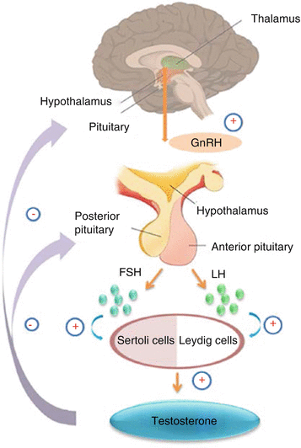
Background and Theory
The HPG (hypothalamic pituitary gonadal) axis regulates the production of testosterone → begins at hypothalamus
Release of GnRH (LHRH) in a pulsatile fashion
LH (Luteinizing Hormone) is also released at this time
Hormone secretion has basal and non basal components
Non-basal secretion caused by feedback signals, which are nonlinear and time delayed.
Exogenous testosterone doses can negatively affect this pathway and inhibit the HPG axis
Previous literature shows long acting testosterone is what causes HPG suppression
Notes:
Reproductive axis regulation begins at hypothalamus
Neurosecretory cells in hypothalamus release GnRH (gonadotropin releasing hormone) in a pulsatile fashion into the hypothalamohypophysial portal ciruction.
Gonadotropes in the anterior pituitary gland respond to this influx of GnRH, resulting in the release of FSH (follicle stimulating hormone) and LH (Luteinizing Hormone). Both of these hormones are crucial in gonadal function
FSH, with testosterone, sustains spermatogenesis, while LH controls androgen synthesis in Leydig cells
Low testosterone levels is often associated with gonadal failure, where increased LH results due to a loss of negative feedback of both androgen and estrogen feedback in men.
Primary gonadal failure is characterized by elevated gonadotropin levels
Hormone secretion has basal and non basal components
Non-basal secretion caused by feedback signals, which are nonlinear and time delayed.
The continuous release of testosterone, the pulsatile release of GnRH, and a combination of both for LH are all forms of non basal secretion.

Slide 4
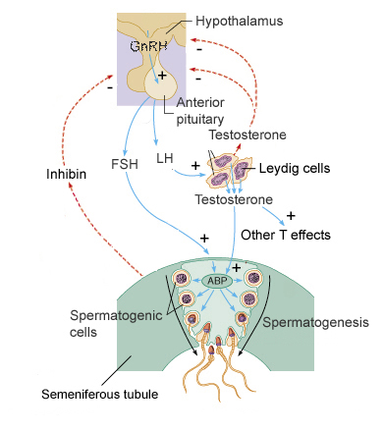
Background and Theory
The HPG (hypothalamic pituitary gonadal) axis regulates the production of testosterone
TRT with exogenous testosterone causes suppression of pituitary gonadotropins, LH, and FSH often resulting in impaired sperm production (Westfield et al)
Introduces short acting testosterone therapy → multiple doses of T with a shorter half life
Minimizes inhibition of the HPG axis, maintains healthy rate of spermatogenesis.
Previous literature shows long acting testosterone is what causes HPG suppression
nau.edu
Notes:
The HPG (hypothalamic pituitary gonadal) axis regulates the production of testosterone
Low testosterone levels are indicative of HPG axis issues
TRT with exogenous testosterone which maintains serum test levels within the mid to normal range causes suppression of pituitary gonadotropins, LH, and FSH often resulting in impaired sperm production (Westfield et al)
Side effects of TRT includes reduced sperm production and azoospermia
Introduces short acting testosterone therapy → multiple doses of T with a shorter half life
Minimizes inhibition of the HPG axis, maintains healthy rate of spermatogenesis.
Previous literature shows long acting testosterone is what causes HPG suppression

Slide 5
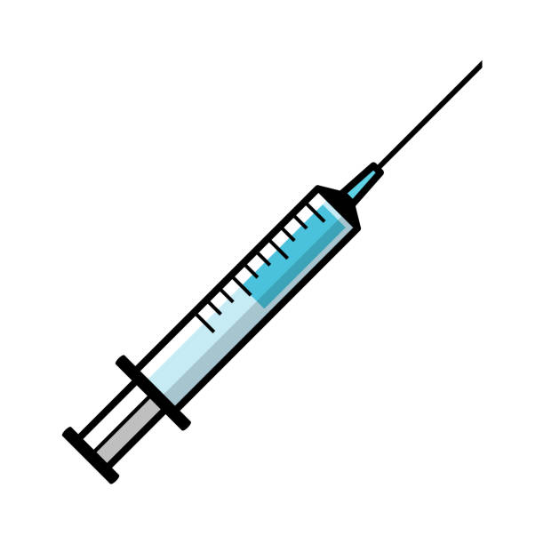
Aim
Our objective is to determine the optimal exogenous testosterone dosage that achieves the following balance:
Maintaining the stability of the HPG system while maximizing the therapeutic benefits of testosterone replacement therapy.
We will explore dosage levels in a simulated model of the HPG axis that render equilibrium, ensuring the physiological integrity of the HPG axis while maintaining the therapeutic advantages associated with exogenous testosterone administration
Notes:
As previously mentioned the level of dosage as well as frequency is extremely important for safe treatment in order to mitigate side effects as optimally as possible.
This is why we want to simulate tests on varying levels in the HPG axis to determine what is safe versus what isn’t by utilizing three primary equations of control which represent the concentration of LHRH in the hypothalamus R(t), the concentration of LH in the pituitary L(t), and the concentration of testosterone in the bloodstream in the testes area T(t), all at time t.
Our objective is to determine the optimal exogenous testosterone dosage that achieves the following balance: maintaining the stability of the HPG system while maximizing the therapeutic benefits of testosterone replacement therapy.
We will explore dosage levels that render equilibrium, ensuring the physiological integrity of the HPG axis while maintaining the therapeutic advantages associated with exogenous testosterone administration

Slide 6
Assumptions and Limitations
We are assuming that the three primary hormones represented in the equations of control are being produced and concentrating only in their respective regions
The model won’t account for potential time variations of parameters between individuals
Time variations and circadian rhythms won’t be accurately accounting for since there are time-of-day variations in hormone levels and hormone secretions patterns won’t be fully captured.
Response and decay rates vary between individuals
Linearity between hormone relationships, hormone clearance rates, and receptor sensitivities will result in discrepancies between simulated and actual hormone levels
Experimental data used to validate model can introduce error
Notes:
The model might simplify the HPG axis. We are assuming that the three primary hormones represented in the equations of control are being produced and concentrating only in their respective regions ( only concentrations of LHRH in the hypothalamic region, LH in the pituitary, and testosterone in the bloodstream).
The model won’t account for potential time variations of parameters between individuals. Working with equations assumes that all humans have constant physiological parameters
.Time variations and circadian rhythms won’t be accurately accounting for since there are time-of-day variations in hormone levels and hormone secretions patterns won’t be fully captured.
While we do know response and decay rates as well as transportation times between hormones, and intervals between releases are being accounted for, they aren’t constant between all humans.
HPG axis is incredibly complex so linearity between hormone relationships, hormone clearance rates, and receptor sensitivities will result in discrepancies between simulated and actual hormone levels
Experimental data used to validate model can introduce error

Slide 7
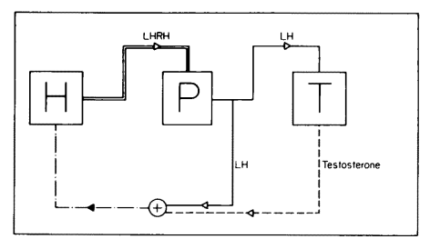
Modeling the HPG Axis
Equations
Model Features
3 equations modeling GNRH, LH, and Testosterone production rates
Parameter values were gathered from experimental data
Hypothalamic GNRH production modeled by a heaviside function
Simplifications
Interindividual and intraindividual variation
Circadian fluctuations, stress, etc
Clearance and absorption
Ṙ(t) = - d_{R}R(T) + r_{R}H(2-L(t- 𝝉_{P-H})/ L̂ - T(t - 𝝉_{T-H})/ T̂)
L˙(t) = -d_{L}L(t) + r_{L}R(t- 𝝉_{H - P})
Ṫ(t) = - d_{T}T(t) + r_{T}L(t - 𝝉_{P - T} - 𝝉₀) + f(s)
Cartwright, (1986)
Notes:
Shubham
We adopted and modified the following system of 3 equations to model the hpg axis’s role in testosterone regulation. We then identified values based on experiments data from a couple different studies for the different parameters. Each equation models the factors that influence the rate of production of each hormone. Each has a self-regulation component. To the third equation, we have added f(s) to represent an exogenous input. The heavyside function in equation 1 acts a switch that turns off GNRH production when testosterone levels or luteinizing hormone levels get too high.
This model does not account for interindividual or intra individual variance. We attempted to do so, but this type of model would require more complex stochastic differential equations. Despite the age and simplicity of the model, it fits human experimental data well. This model does not consider circadian fluctuations and we chose to ignore clearance and breakdown of the hormones since these rates are relatively small

Slide 8
Transfer Function of the Biosystem
Laplace Transform for each of the 3 control equations:
sR̂(s) - R̂(T) = -d_{R}R̂(s) + r_{R}H (2 ^{e^(-𝝉p s) / L} - L̂ (s)/s - T̂(s)/T̂)
sL̂(s) - L̂(0) = - d_{L}L̂(s) + r_{L}R̂(s - 𝝉_{H - P} )
sT̂(s) - T̂(0) = - d_{T}T̂(s) + r_{T}L̂(s - 𝝉_{P - T} -𝝉₀)
Note: s is the complex frequency variable in the Laplace domain and R̂(T) , L̂(0), T̂(0) are the initial conditions.
Notes:
This is not correct

Slide 9
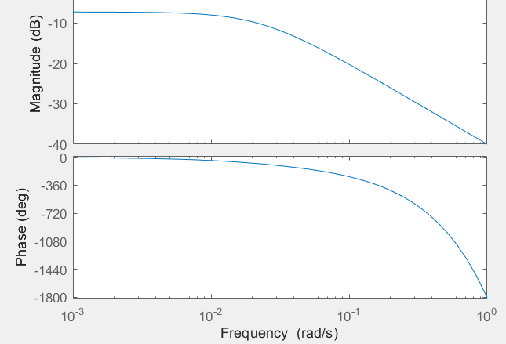
Relationship Between LH Inputs and Testosterone Outputs
Understanding LH and Testosterone
Ṫ(t) = - d_{T}T(t) + r_{T}L(t - 𝝉_{P - T} - 𝝉₀)
H(s) = X
-Time Delay creates instability in isolation
0.01
e^{30s}
s+0.023
1
Notes:
shubham: We first rewrite Equation 3 in transfer function notation with testosterone as an output from LH inputs to understand how these two are related at different frequencies. We see that in isolation, the relationship is unstable at most higher frequency ranges as seen by the phase in the bode plot on the right, due to the 30min time delay between when LH can actually act upon testosterone production. The negative gain at all frequency ranges is expected as hypogonadism is characterized by elevated levels of LH and depressed levels of testosterone. This leads us to our complete system model that we used for our simulation experiments.

Slide 10
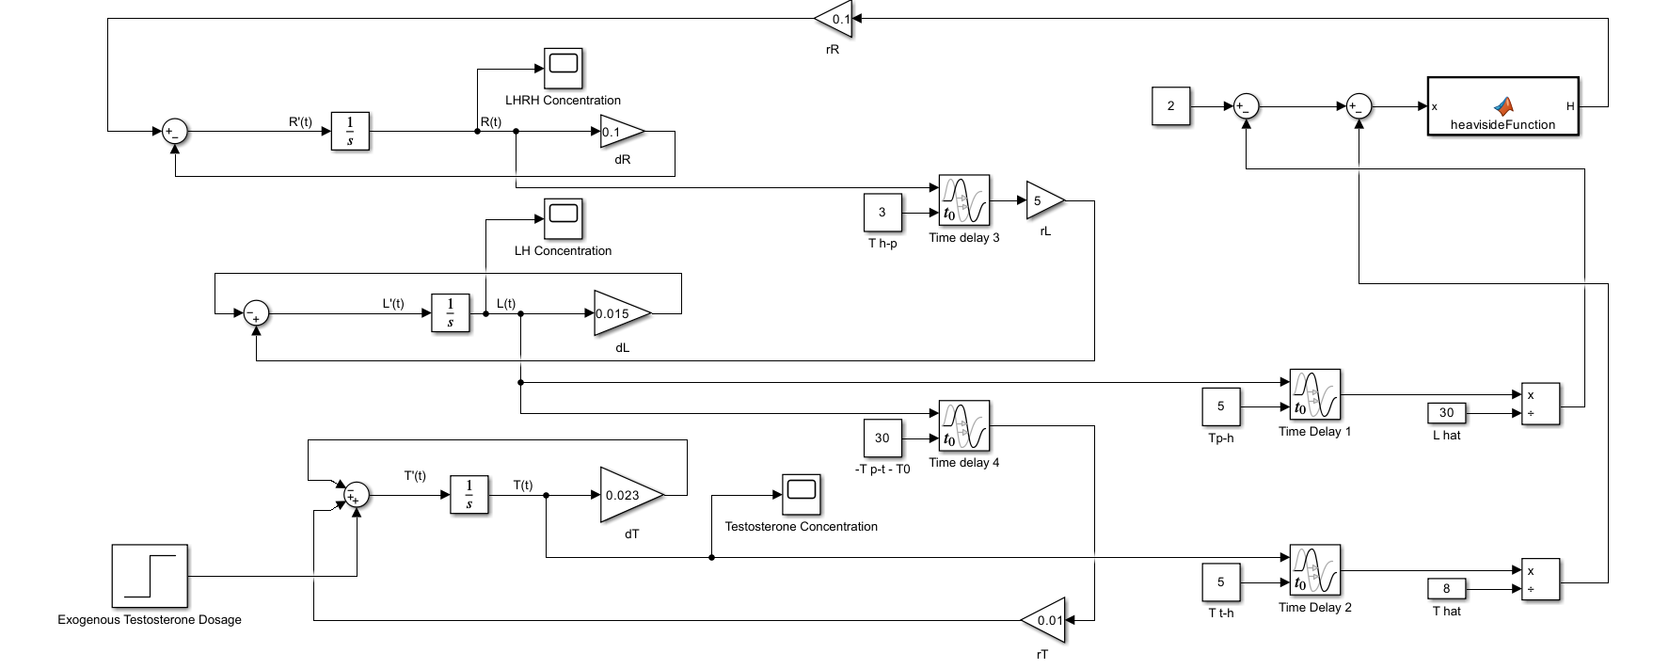
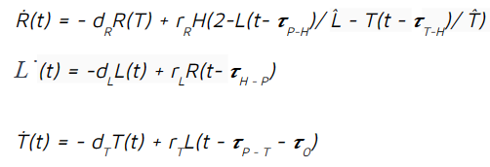
Simulink Block Diagram
+f(s)
Notes:
Need to add f(s) to this

Slide 11
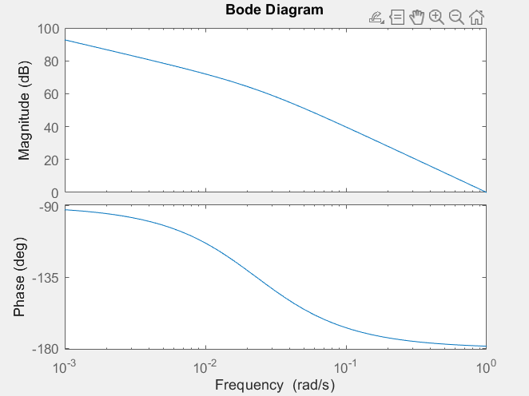
Open Loop Auto-Negative
Feedback of Testosterone
-Under exogenous inputs to the system f(s),
if testosterone becomes too high, GNRH
stops being produced
-Then the system simplifies to the open loop
self-regulation of testosterone
H(s) =
1
s + 0.023
Notes:
Michael: Now considering an exogenous input of f(s). When testosterone levels or LH levels are high enough to turn off GNRH production in the hypothalamus, the entire system simplifies to the open loop system shown here, where, in the absence of positive feedback from luteinizing hormone, testosterone will continuously negatively self-regulate the rate of its own production/release until the rate drops to 0. We use our model to characterize this cutoff point and the behavior leading up to the switch to the open loop

Slide 12
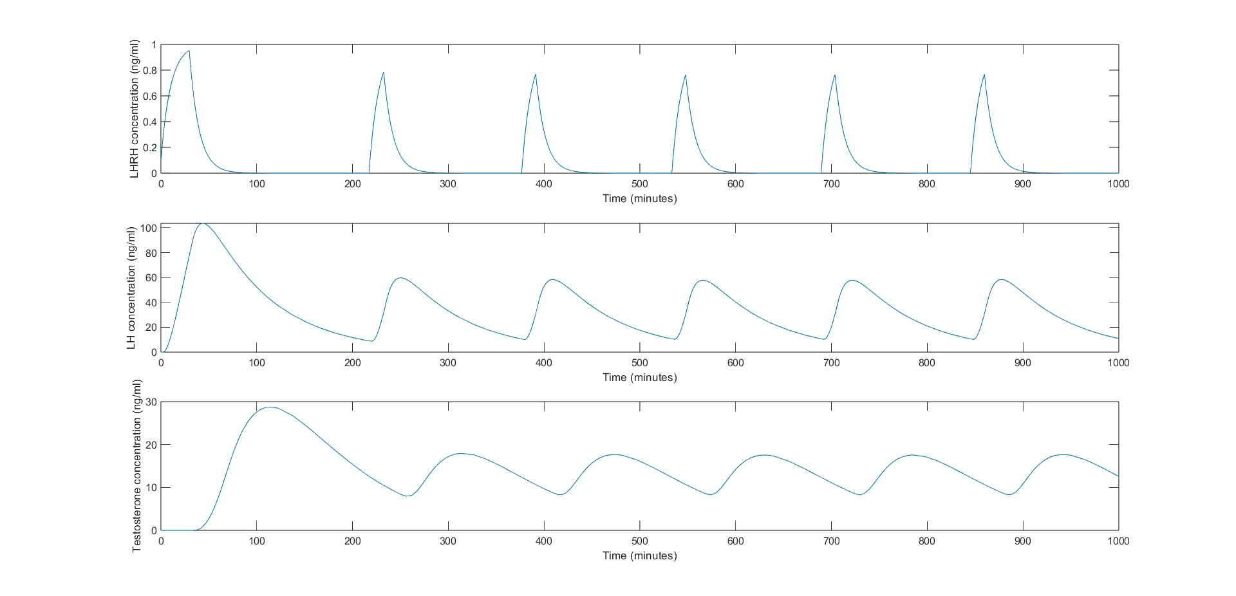
Results
No dosage of testosterone

Slide 13
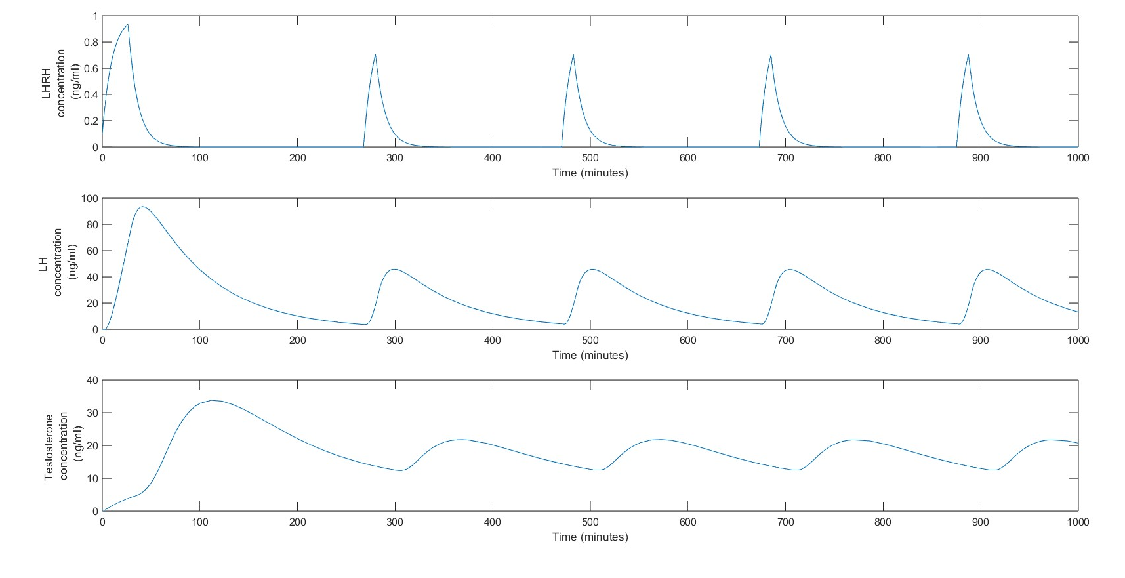
Results
Dosage of 0.2 ng of testosterone
Notes:
Max dosage before pulsating waves become unreliable

Slide 14
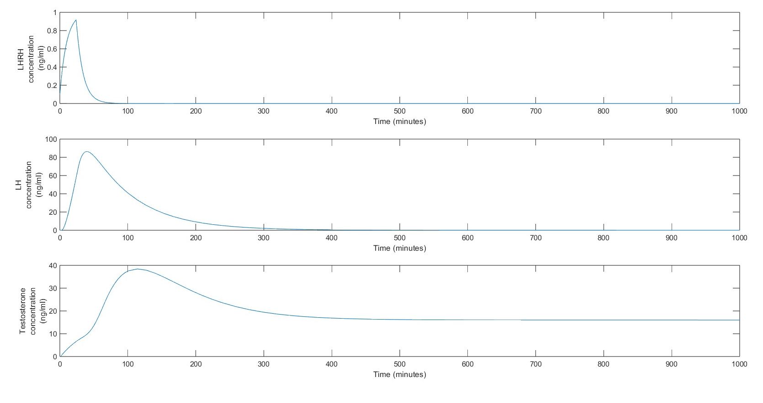
Results
Dosage of 0.368 ng of testosterone
Notes:
Max dosage before pulsating waves become unreliable

Slide 15
Conclusions and Next Steps
Simulated dosages without harm to human subjects
Observed a steady 40% increase in testosterone when administered a 0.2ng/mL dosage
Determined 0.35ng/mL as the approximate safe cutoff of dosage
Please consult a medical professional before considering safe TRT dosages
In the Future:
Contribute to TRT Protocols
Work out a complete closed loop transfer function under conditions of hypothalamic activation

Slide 16
Future Applications
Hope to contribute to optimizing TRT protocols
Personalized treatment for testosterone related disorders
Increase prevention of gonadal dysfunction
More informed clinical decision making in hospital settings
Results can serve as preface for drug development for testosterone regulation
Notes:
-As opposed to physical experiments in hypogonadal men, by modeling their physiology, we were able to simulate unsafe dosages and observe their effects
-Observed a steady 40% increase in testosterone when administered a 0.2ng dosage
-Our model defines 0.35 as the approximate safe cutoff of dosage
-Please consult a medical professional before considering safe TRT dosages

Slide 17
References
Bayview Pharmacy. “Testosterone Replacement Therapy (TRT): A Complete Overview.” Bayview Pharmacy, www.bayviewrx.com.
Westfield, Gerwin, et al. “Short-Acting Testosterone: More Physiologic?” Frontiers in Endocrinology, vol. 11, 2020, doi:10.3389/fendo.2020.572465. www.frontiersin.org.
Keenan, Daniel. A Stochastic Biomathematical Model of the Male Reproductive Hormone ..., epubs.siam.org/doi/10.1137/S0036139998334718.
Orchidia Medical Group. “6 Benefits of Testosterone Replacement Therapy You Shouldn’t Miss Out on.” Orchidia Medical Group, www.orchidiamedicalgroup.com.

