Slide 1
2 & 3-Element Windkessel Model Analysis:
The Arterial System and Its Response to Vasoactive Drug Impact
Sophia Benkirane, Sophia Lam, Angela Liu, Ly Nguyen, Nikhita Sujan | December 7, 2023

Slide 2
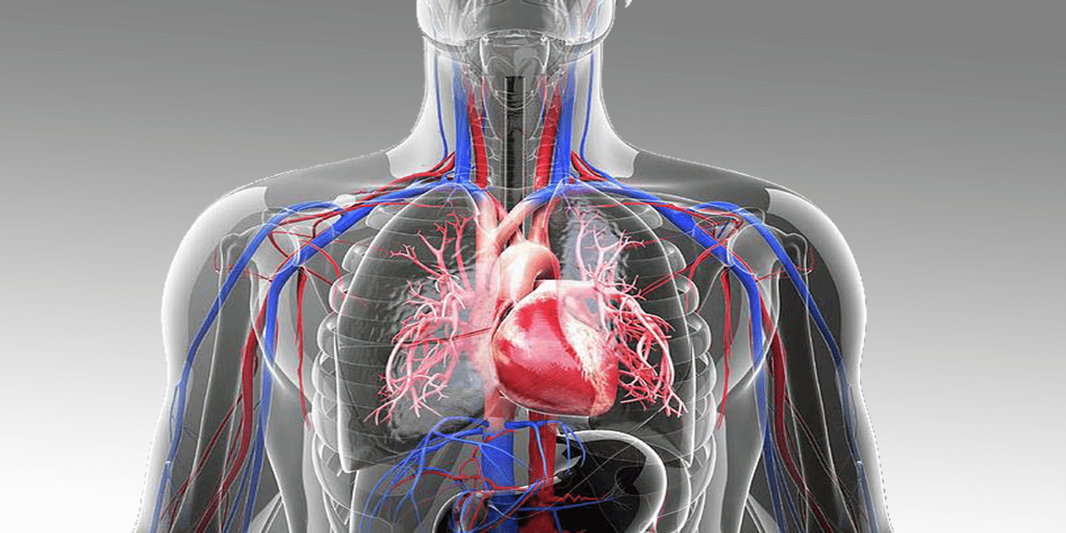
Overview
Table of Contents
Basic Background
Aim of our model
Assumptions of WM
Defining relevant equations
Analyzing the transfer function
Building a block diagram
Results: System response

Slide 3
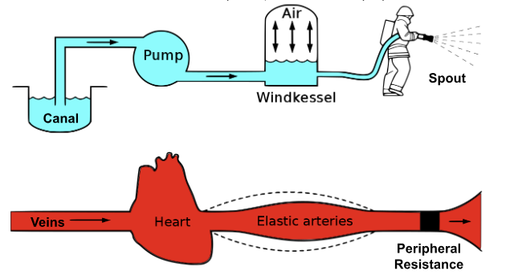
Background: The Windkessel Analogy
Canal → Veins
Pump → Heart
Windkessel → Large Elastic Arteries (aorta)
Spout → Peripheral Resistance
Figure 1: The Windkessel analogy illustrated.
Notes:
Script: In this slide we have description of an early Windkessel model that was given by the German physiologist, Otto Frank in 1899. The Windkessel model provides a solution by allowing simulation and analysis of the dynamic response of the cardiovascular system, helping to quantify the changes in arterial compliance and peripheral resistance. the model demonstrates that when compliance occurs, aortic valves and peripheral resistance come together, meaning that peripheral flow becomes constant. This helps regulate blood flow and maintain homeostasis in the cardiovascular system.
Arterial Compliance Simulation:
In simpler terms, is measured by the blood pumped into the heart that compresses the Windkessel–or in this case the elastic arteries. This simulates the elasticity and extensibility of major arteries, reflecting the vessel’s ability to expand under pressure.
Peripheral Resistance Simulation:
Here, blood encounters resistance while leaving the Windkessel and flowing back to the heart. This represents the resistance to blood flow in the arterial tree, from major arteries to capillaries, demonstrating the effect of decreasing vessel diameter. The exhibited resistance to flow is known as peripheral resistance.
Furthermore, the model demonstrates that when compliance occurs, aortic valves and peripheral resistance come together, meaning that peripheral flow becomes constant. This helps regulate blood flow and maintain homeostasis in the cardiovascular system.

Slide 4

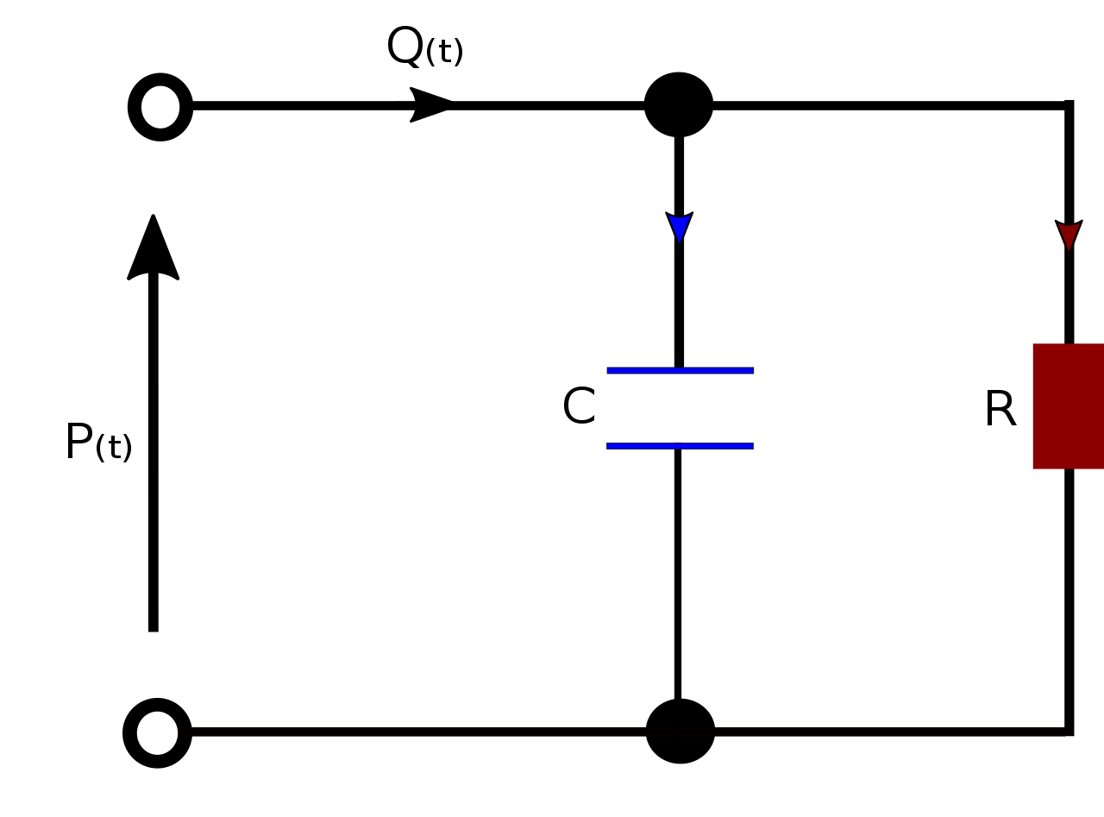
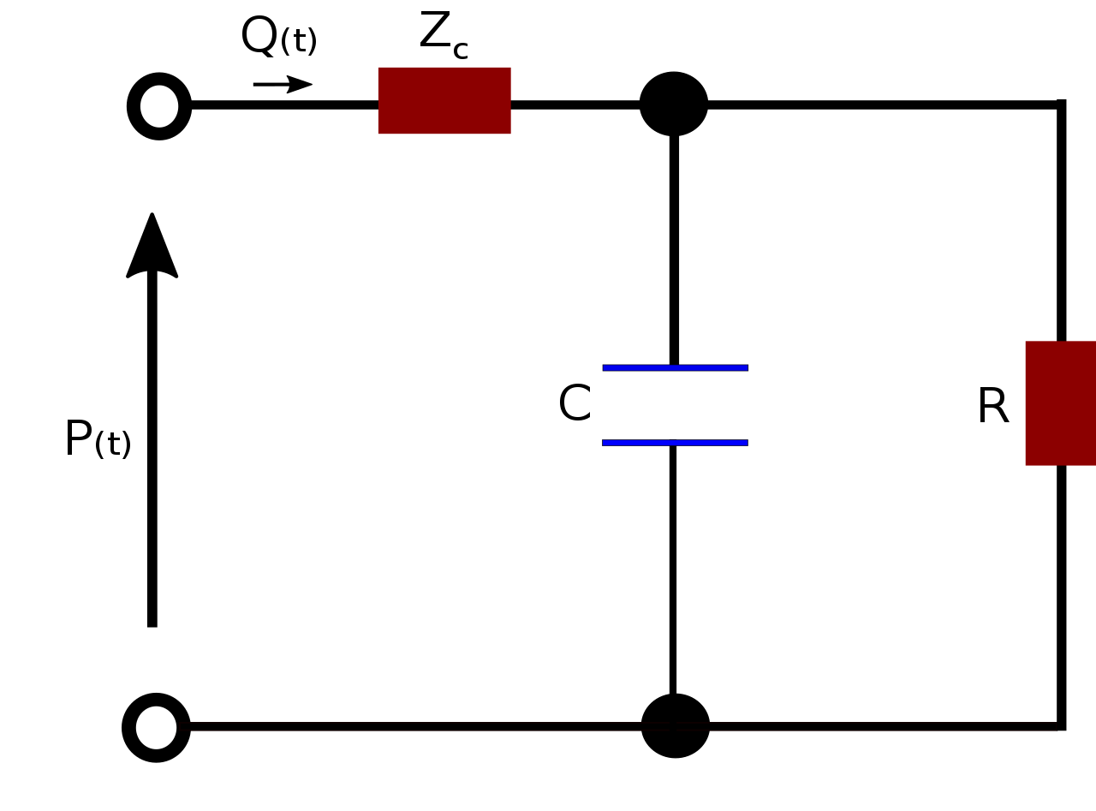
Background: 2 vs 3-Element Windkessel Model
i(t)
i(t)
u(t)
u(t)
Figure 2: Two-Element electrical circuit representing cardiovascular blood flow dynamics
Figure 3: Three-Element electrical circuit representing cardiovascular blood flow dynamics
Notes:
For this analysis, we’ll be detailing the 2 and 3-element WM. The 2-element model corresponds to a simplified circuit featuring a resistor (analogous to arterial resistance) and a capacitor (representing arterial compliance). This basic model neglects inertial effects and additional resistive components. In contrast, the 3-element model introduces an extra resistor (analogous to valve resistance) to capture the intricacies of aortic valve dynamics. This extension allows for a more nuanced representation of the arterial system, particularly in modeling blood flow dynamics impacted by the opening and closing of the aortic valve. In electrical terms, the 3-element model resembles a circuit with two resistors (arterial resistance and valve resistance; Z_c) and a capacitor (arterial compliance), offering a more detailed and physiologically accurate simulation of cardiovascular dynamics.
Input: Volumetric blood flow (Current i(t))
Output: Blood Pressure with respects to time (Output voltage u(t))

Slide 5
Aim: Cardiovascular Dynamics & Drug Impact
What we know:
The Windkessel model simulates the heart and arterial system as a hydraulic circuit, emphasizing the characteristics of load on the heart and relationship between blood pressure and blood flow.
What we want?
To understand and simulate the dynamics of blood flow & pressure via the 2 and 3-Element Windkessel Models and to further, investigate the response under constricted and dilated conditions.
Why?
The administration of vasoactive drugs (i.e. vasoconstrictors or vasodilators) is common in clinical settings. However, predicting their effects on the cardiovascular system and optimizing dose is challenging.
Notes:
(7) Introduction: Cardiovascular dynamics plays a pivotal role in understanding heart function and blood circulation. The Windkessel model simulates the heart and arterial system as a hydraulic circuit, emphasizing the characteristics of load on the heart and relationship between blood pressure and blood flow.
Problem statement: To understand and simulate the dynamics of blood flow & pressure via the 2 and 3-Element Windkessel Models and to further, investigate the response under constricted and dilated conditions. These conditions can be exhibited under the influence of vasodilator & vasoconstrictor drugs.
Motivation statement: The administration of vasoactive drugs, such as vasodilators or vasoconstrictors, is common in clinical settings. However, predicting their effects on the cardiovascular system and optimizing dose is challenging. The Windkessel model provides a solution by allowing simulation and analysis of the dynamic response of the cardiovascular system to these drugs.

Slide 6
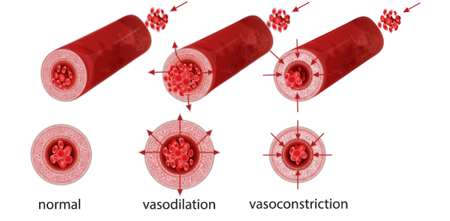
Vascular Dynamics
Vasodilator
Prevent the contraction of artery and vessel walls
E.g. Nitroprusside, Labetalol, etc.
Vasoconstrictor
Induce the narrowing of artery and vessel walls
E.g. Medicine containing dopamine, epinephrine, etc.
Figure 4: Illustration of Dynamic Vascular Responses: Normal, dilated, and constricted condition.
Notes:
Vasodilation occurs when the muscles in your blood vessel walls relax. When you take a vasodilator, the blood vessel’s middle interior (lumen) is the part that widens. Vasodilators widen vessels, decreases vascular resistance, enhances blood flow, and often leads to a lowering of blood pressure.
Nitroprusside, which is used mostly in emergencies and is administered through an IV
Labetalol, which can treat severe hypertension (high blood pressure) during labor and prevent eclampsia and hemorrhaging
Vasoconstrictors narrow blood vessels, increasing vascular resistance and leading to a reduction in blood flow, which can elevate blood pressure and alter organ perfusion.
Many vasoconstrictors are hormones that are found in the body.
E.g. Medicine containing dopamine, epinephrine, etc.

Slide 7
2 WM: Normal vs Dilated vs Constricted Blood Pressure
Effect of Vasodilator Drugs
↓ R, ↑ C
Effect of Vasoconstrictor Drugs
↑ R, ↓ C
*↑ = Increase *↓ = Decrease
 | R [mmHg.s.cm⁻³] | C [cm³.mmHg⁻¹.s².cm⁻³]
Normal | 0.79 | 1.75
Dilated | 0.63 | 5.16
Constricted | 1 | 1
*Values obtained by [4] for normal, dilated, and constricted human parameters of the WM
Notes:
Throughout the simulations of each of these models, we use the same human parameter values shown in the Table
Effects of Vasodilator Drugs
Resistance (R): Decrease: Vasodilators typically relax blood vessels, leading to a reduction in resistance. This is especially true in the arterioles and small arteries.
Compliance (C): Increase: Vasodilators can enhance arterial compliance by promoting vessel dilation and reducing stiffness.
Characteristic Resistance (Z_c): Decrease: Vasodilators may contribute to a decrease in characteristic resistance, particularly in large arteries.
Effects of Vasoconstrictor Drugs
Resistance (R): Increase: Vasoconstrictors lead to the constriction of blood vessels, resulting in an increase in resistance, particularly in arterioles and small arteries.
Compliance (C): Decrease: Vasoconstrictors can cause reduced arterial compliance by inducing vessel constriction and increasing stiffness.
Characteristic Resistance (Z_c): Increase: Vasoconstrictors may contribute to an increase in characteristic resistance, especially in large arteries.
**
adding a PID controller, demonstrates a slower but steady increase in resistance to combat the effect of the dilated vessel that decreased the resistance of the arterial walls (negative PID values)
**
adding a PID controller, gives a decrease in the resistance from the scope because it stabilizes the arterial system, making the vessel's response to the constrictor drug slower

Slide 8
3 WM: Normal vs Dilated vs Constricted Blood Pressure
Effect of Vasodilator Drugs
↓ R, ↑ C, ↓ Z_{c}
Effect of Vasoconstrictor Drugs
↑ R, ↓ C, ↑ Z_{c}
*↑ = Increase *↓ = Decrease
 | R [mmHg.s.cm⁻³] | C [cm³.mmHg⁻¹.s².cm⁻³] | Z_{c} [mmHg.s.cm⁻³]
Normal | 0.79 | 1.75 | 0.033
Dilated | 0.63 | 5.16 | 0.030
Constricted | 1 | 1 | 0.050
*Values obtained by [4] for normal, dilated, and constricted human parameters of the WM
Notes:
Effects of Vasodilator Drugs
Resistance (R): Decrease: Vasodilators typically relax blood vessels, leading to a reduction in resistance. This is especially true in the arterioles and small arteries.
Compliance (C): Increase: Vasodilators can enhance arterial compliance by promoting vessel dilation and reducing stiffness.
Characteristic Resistance (Z_c): Decrease: Vasodilators may contribute to a decrease in characteristic resistance of blood flow, particularly in large arteries.
Effects of Vasoconstrictor Drugs
Resistance (R): Increase: Vasoconstrictors lead to the constriction of blood vessels, resulting in an increase in resistance, particularly in arterioles and small arteries.
Compliance (C): Decrease: Vasoconstrictors can cause reduced arterial compliance by inducing vessel constriction and increasing stiffness.
Characteristic Resistance (Z_c): Increase: Vasoconstrictors may contribute to an increase in characteristic resistance, especially in large arteries.

Slide 9
Windkessel Model Assumptions
Simplifying the System
1
Cardiac cycle starts at systole (heart pumps blood from chamber to arteries).
2
System is in a steady-state.
3
Arteries are treated as passive conduits, neglecting valve-like effects.
4
Continuous pulsatile blood flow is present.
5
Arterial Compliance, Peripheral Resistance, and Inertia are modeled as a C, R, and Z_{c}.

Slide 10
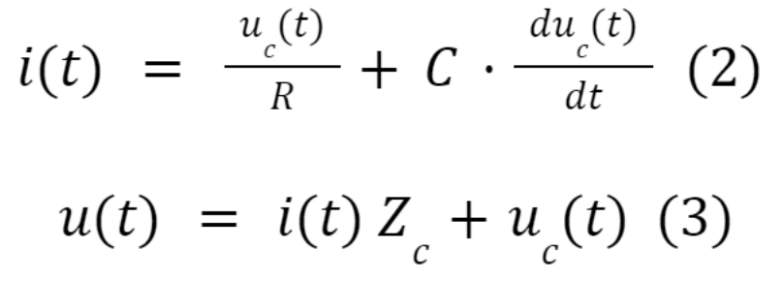
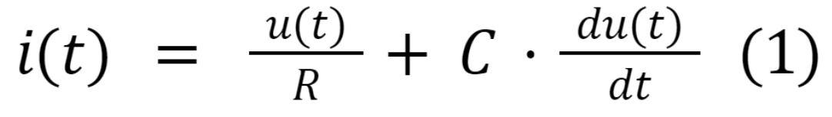
Control System Design: Ordinary Differential Equations
Differential equation governing 2 WM.
Differential equations governing 3 WM.
Notes:
Script: The equation governing 2 windkessel model represents blood pressure, blood flow, peripheral resistance, total arterial compliance, to describe the dynamics of blood flow. while the differential equations governing 3 windkessel model show that Z represents the resistance to alternating blood flow is added.
2-Element Model:
u_{c}(t) = Blood pressure in the compliance element -> output voltage
i(t) = Blood flow -> input voltage
R = Total peripheral resistance
C = Total arterial compliance
3-Element Model:
Z is the impedance, representing the (aortic or pulmonary) resistance to alternating blood flow is added
Releates blood pressure, blood flow, peripheral resistance, total arterial compliance, and inertance to describe the dynamics of blood flow.

Slide 11
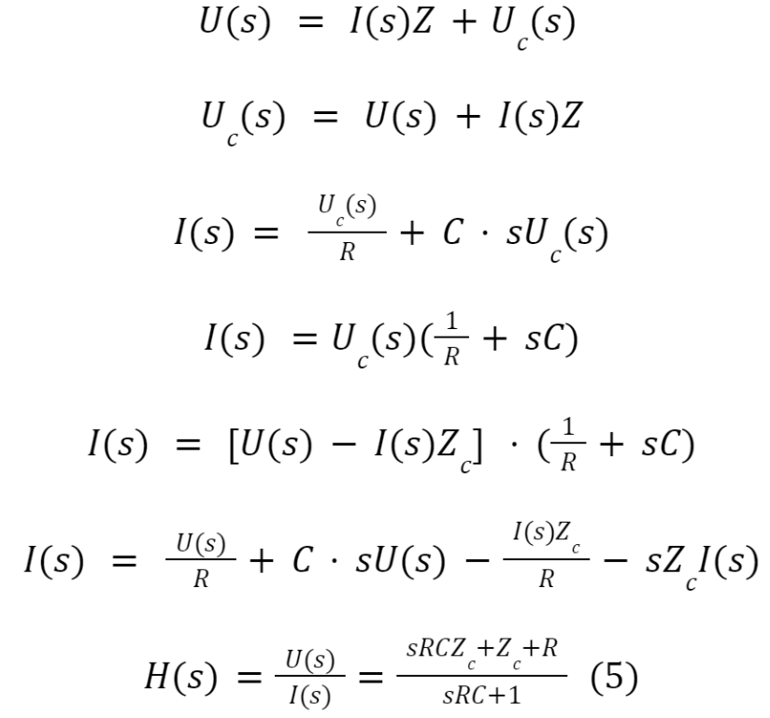
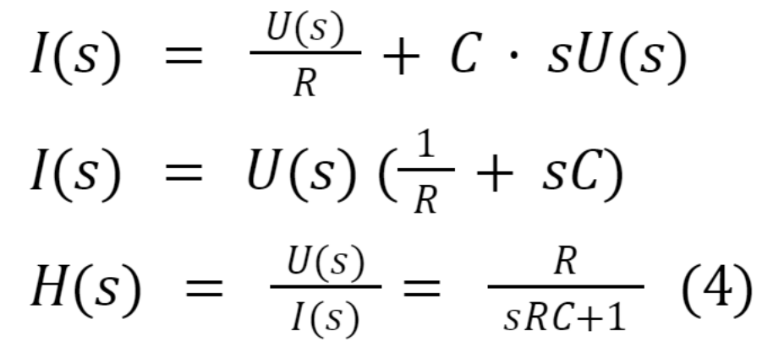
Laplace Transform
From
eq. (2)
From
eq. (3)
From
eq. (1)
Notes:
Significance of Laplace Transform:
provides insight into the system’s dynamics, frequency response, stability, and transient response
specifically, the transfer function analyzes the blood flow signals at different frequencies and provides numerical information for the input blood flow and output pressure response rates
By utilizing two ordinary differential equations, you've derived Laplace transfer functions essential for analyzing blood flow signals across different frequencies. These functions offer numerical information on input blood flow and output pressure response rates, allowing for a focused examination of blood pressure and cardiac output dynamics. This analysis in the frequency domain lays the groundwork for designing effective control systems to better understand and manage cardiovascular function.

Slide 12
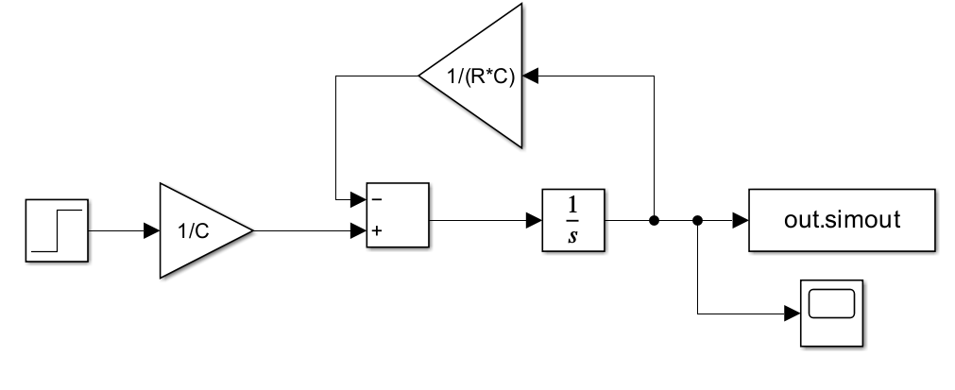
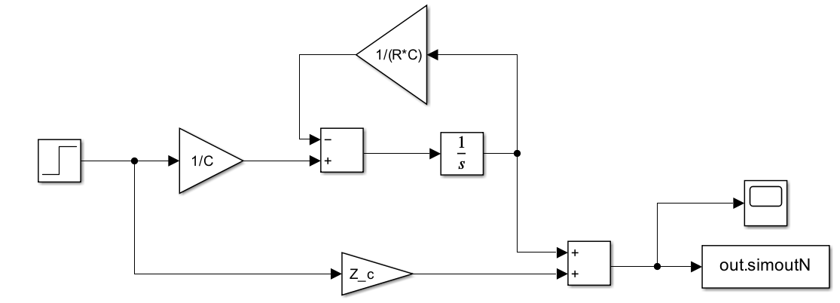
2 WM vs 3 WM Simulink
Figure 5: Two-Element WM Simulink Model.
Figure 6: Three-Element WM Simulink Model
Notes:
The biggest difference between these two models is the inclusion of the Z_c in the model which provided a more accurate simulation of the cardiac cycle.
2 Feedback and 1 feedforward
2nd order system

Slide 13
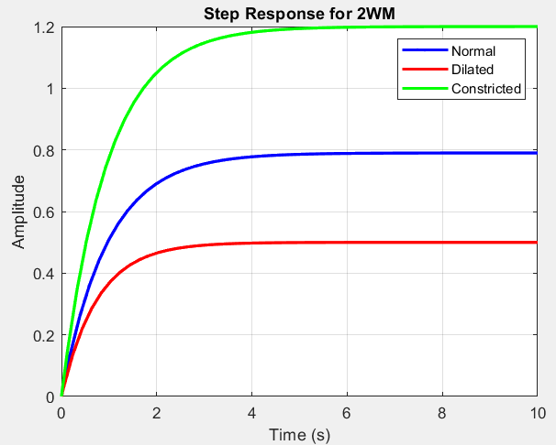
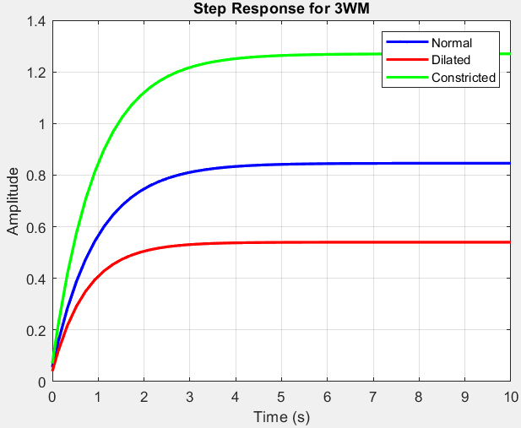
Step Response of the System
Figure 7: Normal, dilated, and constriction conditions for Step Response of 2 WM.
Figure 8: Normal, dilated, and constriction conditions for Step Response of 3 WM.
Notes:
On this slide, we compare the step responses of our cardiovascular system models. The Simulink plot for the two-element Windkessel model reveals a lower step response compared to the three-element model, highlighting the latter's enhanced ability to capture dynamic changes in the system. This can be attributed to how the 2-element model is lacks the arterial inertia compared to the 3 element model, thus resulting in a more realistic response.

Slide 14
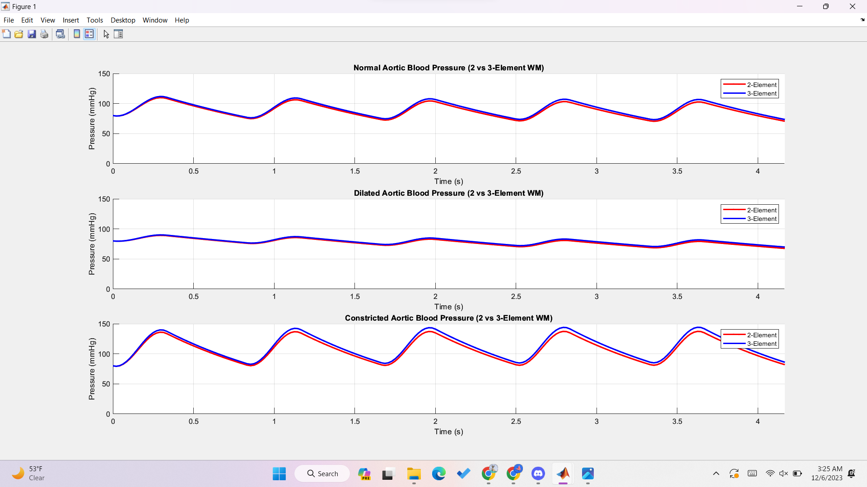
Output Response u(t): Blood Pressure
Figure 9: Normal, dilated, and constriction conditions for blood pressure output [mmHg].
Notes:
In the 2-element model, blood pressure dynamics are primarily influenced by both resistance and compliance.
The 3-Element Windkessel Model introduces inertial effects, accounting for the acceleration and deceleration of blood flow. This component considers the mass of blood and the elasticity of the arterial walls, providing a more comprehensive representation of the blood output.
Incorporating characteristic resistance, Zc, in the 3-element model enhances its ability to simulate physiological phenomena such as wave reflections and more accurately captures the dynamics of blood flow, especially during rapid changes in pressure. As seen in the N, D, and C figures, the impact of inertial effects during systole and diastole are shown via the wave reflections.
N: 106-109
D: 88
C: 142
Effect of Vasodilator Drugs
↓ R, ↑ C
Effect of Vasoconstrictor Drugs
↑ R, ↓ C

Slide 15
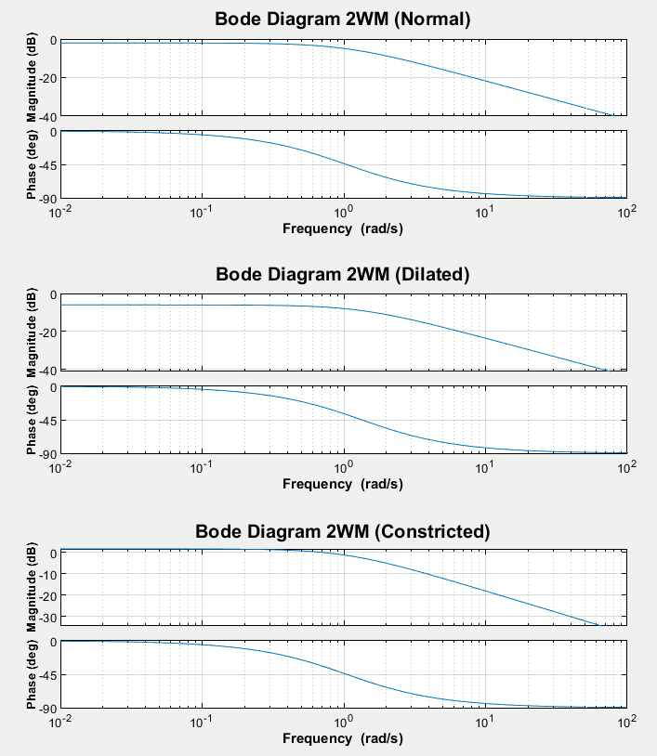
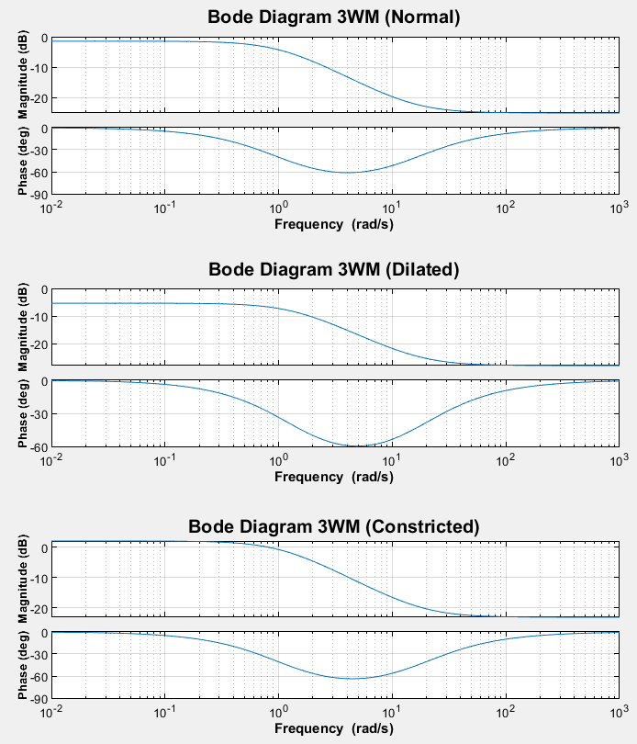
Bode Plot
Figure 10: Bode diagram for normal, dilated, and constriction conditions using the 2-Element model
Figure 11: Bode diagram for normal, dilated, and constriction conditions using the 3-Element model
Notes:
Script:From the derived Laplace transfer function and the given parameters for each condition, the Bode plot can be found to depict the frequency response of both the 2-element and 3-element Windkessel models. The 2-element model exhibits a smoother magnitude roll-off, while the 3-element model introduces complexity with resonance effects, as indicated by a phase shift reaching 90 degrees at the resonant frequency and back to 0 degrees. Consequently, the magnitude changed to represent the physiological changes of the blood vessels according to the parameters. y. It is also key to mention that the Bode diagrams resemble the behavior of a low pass filter indictable a stable system.

Slide 16
References
R, K. Arterial dilation and reduced wave reflection. Benefit of dilevalol in hypertension. AHA Journals. (1989). https://doi.org/10.1161/01.HYP.14.1.14
Safar, M. E.. Windkessel Effect. Science Direct (2007) https://doi.org/10.1016/B978-0-323-03961-1.50016-7
Sica, D. A. (2007). Direct Vasodilators and their Role in Hypertension Management: Minoxidil. National Library of Medicine. https://doi.org/10.1111%2Fj.1524-6175.2001.00455.x
Westerhof, N et al. “An artificial arterial system for pumping hearts.” Journal of applied physiology vol. 31,5 (1971): 776-81. doi:10.1152/jappl.1971.31.5.776

